Slide 1

Customer Purchase Behavior Analysis – Diwali Compaign
Understanding the Festive Market

Slide 2
Project Overview
Analyze Behavior
Uncover Patterns
Enhance Marketing
Deep dive into consumer actions during Diwali.
Identify key purchase trends and preferences.
Provide actionable insights for businesses.

Slide 3

Dataset at a Glance
Source
Diwali Sales Dataset
Size
11,251 Rows
Key Columns
User_ID, Gender, Age
Occupation, Marital_Status
Product_Category, Purchase, State

Slide 4




Tools & Technologies
Python
Jupyter Notebook
Core language for analysis.
Interactive data exploration (Anaconda).
Pandas
Matplotlib & Seaborn
Data manipulation and analysis.
Powerful visualization libraries.

Slide 5

Data Preparation
Clean Nulls
Ensuring data integrity.
Drop Irrelevant
Removed User_ID, Product_ID for focus.
Correct Types
Optimizing data for analysis.

Slide 6
Exploratory Data Analysis (EDA)
Key Areas of Investigation
1
2
3
Gender Purchases
Age Group Trends
Occupation Insights
Who buys what?
Demographic spending habits.
Profession-based spending.
4
5
State Performance
Product Categories
Geographical sales variations.
Top-selling items.

Slide 7
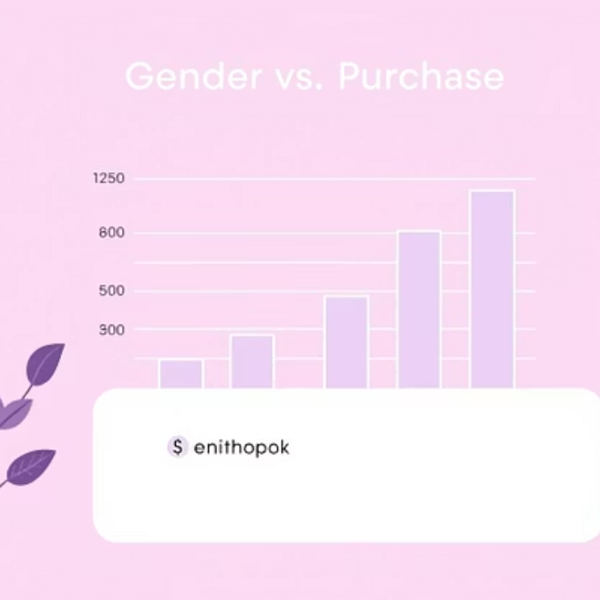
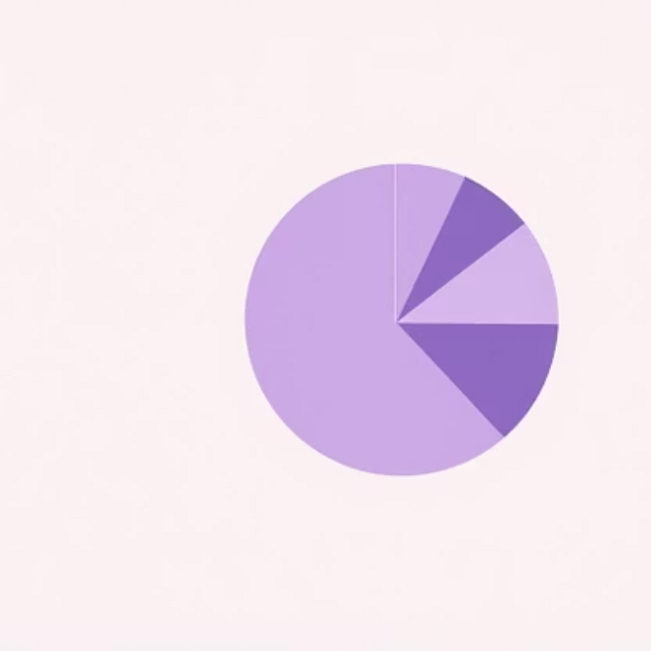
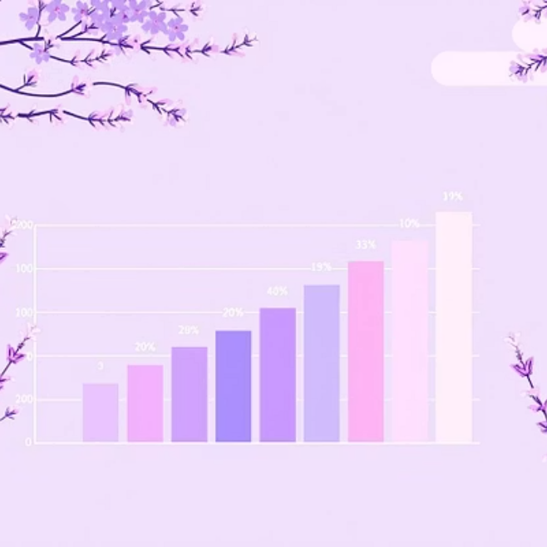
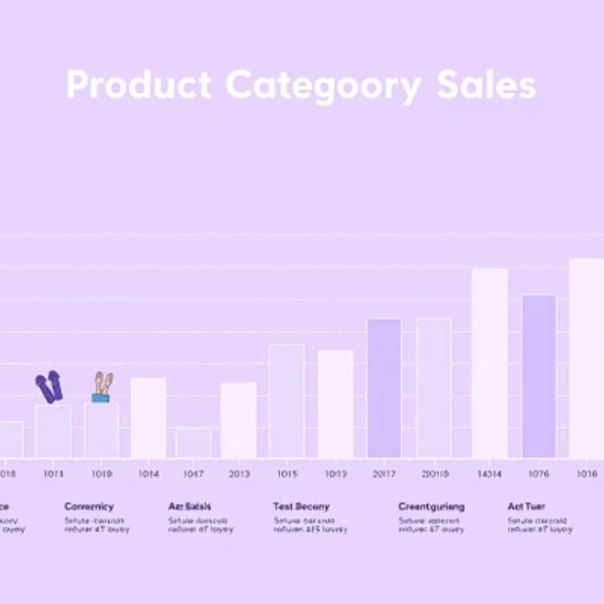
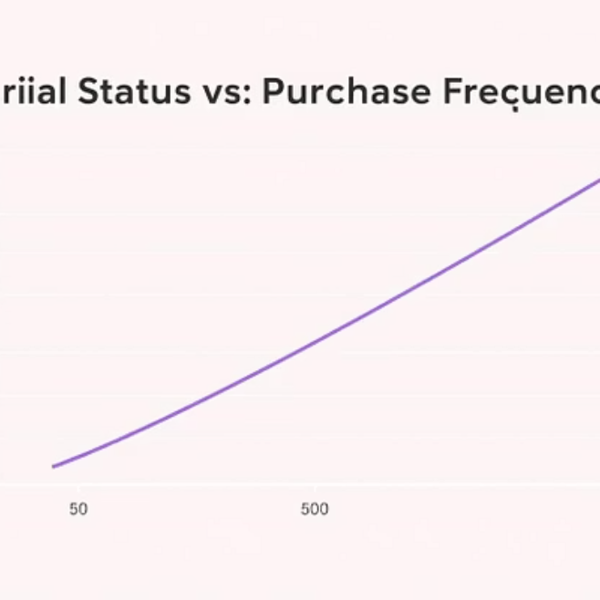
Visualizing Key Insights
Charts that tell the story

Slide 8

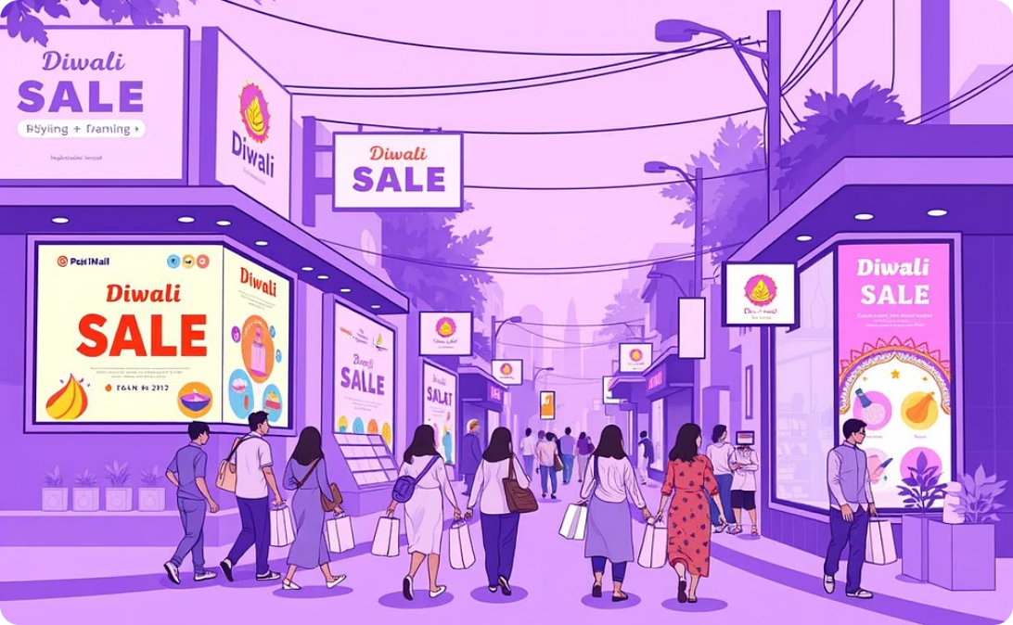
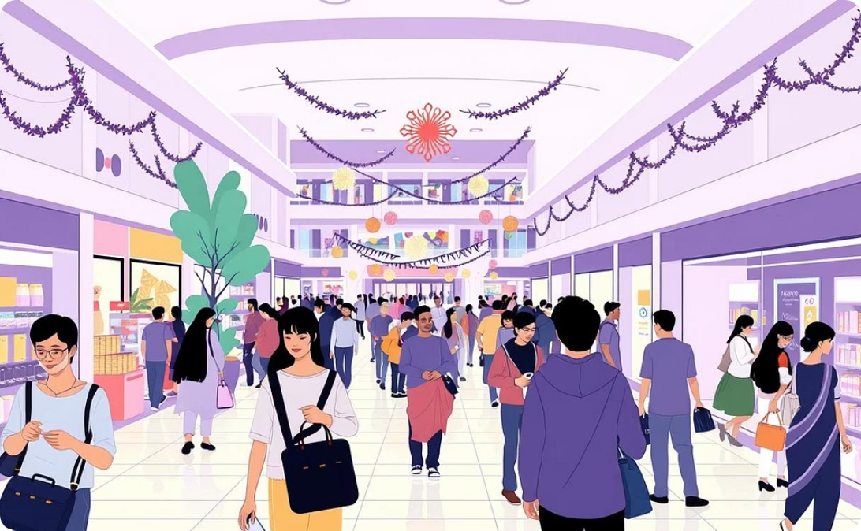
Top Performing States
Uttar Pradesh
Maharashtra
Karnataka
Leading the sales charts.
Significant market presence.
Strong purchasing power.

Slide 9

Who is the Top Buyer?
Married Women (26-35)
From UP, MH, & KA.
Working in IT, Aviation, Healthcare.
Prefer Food, Clothing, Electronics.

Slide 10

Next Steps & Resources
Leverage Insights
Target marketing efforts to key demographics and regions for maximum impact.
🔗 Project Name --Customer Purchase
Behavior Analysis – Diwali Campaign.
https://github.com/rashmichavhan/Python-Project
Optimize Inventory
Stock popular product categories based on identified trends.
Explore More
GitHub Repository
Dive into the full analysis on GitHub.

